Slide 1
5.4.3: Variance and Standard error
Aarushi Pandey (axp180064) and Simon Kim (sxk190106)

Slide 2

Variance
The Sample cannot always be the same.
Statistics from samples distribute.
“How much we expect it to vary as a function of the data sample?”
Variance of the sample mean:
A way of quantifying error
Prefer low variance

Slide 3

Standard error
Standard error: square root of variance
standard deviation of the sample mean
The expected degree of variation in any estimator -> source of error to quantify
Why standard error?
estimate of the true underlying parameter is uncertain
same distribution but different statistics
shows how much we expect it to vary as a function of the data sample

Slide 4
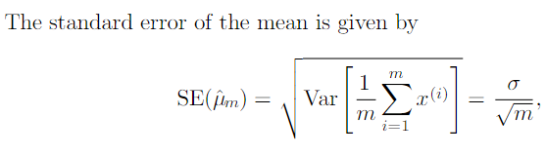
Standard error
σ squared is the true variance of the samples x^{i}
Square root of sample variance or square root of unbiased estimator of variance do NOT provide unbiased estimate of standard deviation
Still used in practice but underestimate it
Square root of unbiased estimator is more accurate (especially for larger data size)

Slide 5

Variance and Standard error
How is it useful?
Generalization error estimated by sample mean of error on text set
Accuracy dependant on number of examples in test set
“use the standard error to compute the probability that the true expectation falls in any chosen interval”
95% confidence interval centered on mean:

Slide 6

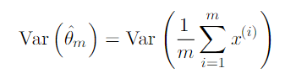
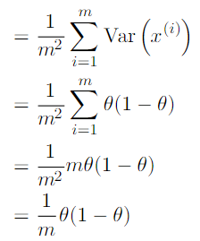

Variance and Standard error
Example - Bernoulli Distribution
Consider a set of samples drawn independently and identically from a Bernoulli distribution
Variance of estimator decreases as a function of observations in the dataset

